Slide 1

UNO Flip Remix: Revision 1 Demo
An exciting walkthrough of our UNO Flip Remix game.
This presentation will demonstrate our implementation of the game, the challenges we faced, and the solutions we developed.
Presented by: Team 24

Slide 2


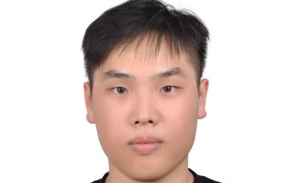
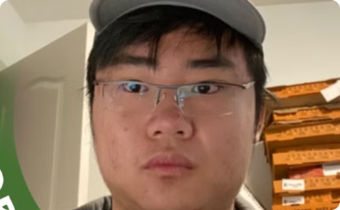
Meet the team
Kevin Ishak
Zain Garada
Mingyang Xu
Jianhao Wei
Project Manager
UI/UX Expert
Back End Developer
Full Stack Developer

Slide 3
Roadmap
Introduction
1
Introduce the project's core concepts and objectives to the audience.
2
Meet the Team
Introduce each member and their roles in developing UNO Flip Remix.
Project Goals
3
Clearly define what we aimed to achieve with this iteration of UNO Flip Remix.
4
Live Demo
Showcase the current state of UNO Flip Remix in action.
Design Process
5
Explain the iterative design stages and decisions made during development.
6
Comparison to Competitors
Analyze how UNO Flip Remix stands out from existing card games.
Story - From Zero to Flip
7
Tell the story of the project's evolution from its initial concept.
8
SRS Alignment and Code Goals
Detail how the project adheres to the Software Requirements Specification.
Technical Specifications
9
Outline the technical aspects and architecture of UNO Flip Remix.
10
Usability Testing Feedback
Present insights gained from user testing sessions.
GenderMag Analysis
11
Explain the findings of the GenderMag analysis and their impact on design.
12
Project Qualities
Highlight the defining characteristics that make UNO Flip Remix unique and enjoyable.
Testing and Validation
13
Summarize the rigorous testing procedures used to ensure game quality.
14
Impact and Takeaways
Reflect on the project's overall impact and the key lessons learned.
Disadvantages and Future Work
15
Acknowledge current limitations and outline plans for future development.
16
Conclusion and Questions
Wrap up the presentation and open the floor for questions.

Slide 4


Project Goals
Problem Statement
Our Solution
The current version of UNO Flip fails to offer an enjoyable online experience.
A complete digital UNO Flip Remix with multiplayer and rule-based AI.
Existing implementations lack polish and accessibility.
Built for fun, strategy, and smooth play — whether solo or with friends.

Slide 5
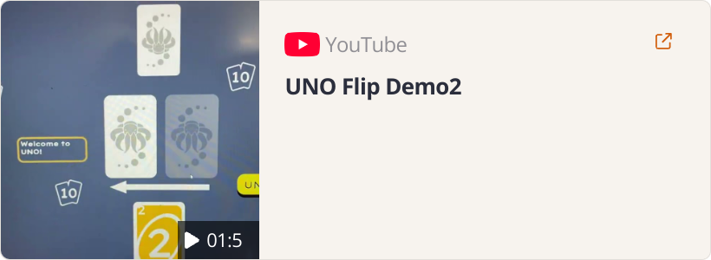
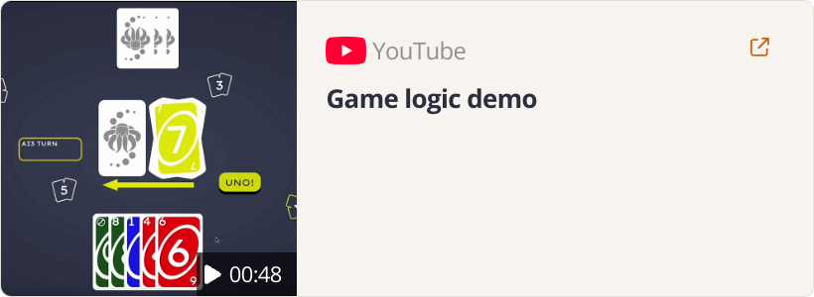
Live Demo
Multiplayer Synchronization
End Game
Demonstrates the initial setup of the game, including player registration and game logic.
Shows a player successfully emptying their hand and winning the round.

Slide 6
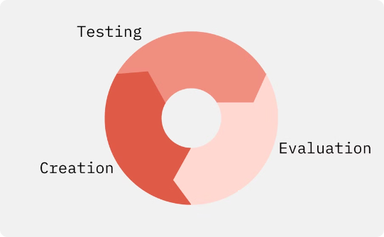


Design Process
Iterative Design Process
Feedback
Documentation
Built → Tested → Refined
Refinements based on direct feedback
Traceable and Transparent

Slide 7
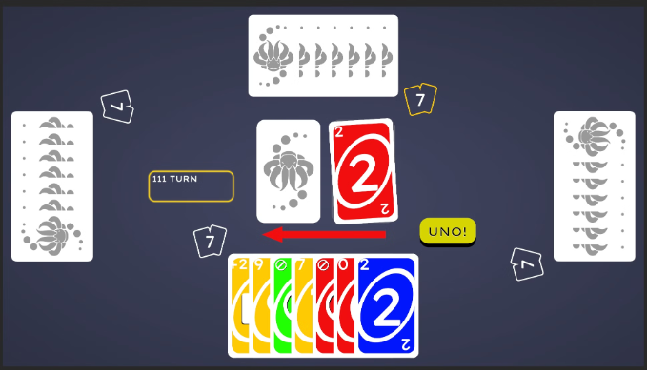
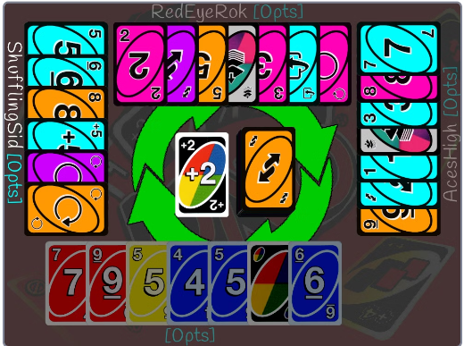
Comparison to Competitors
UNO Flip Remix (Team 24)
UNO Flip (Official App)
Our remix enhances the classic UNO Flip with improved multiplayer synchronization, rule-based AI, and a polished user experience.
The official UNO Flip app provides a basic digital version of the game but often lacks the strategic depth and engagement of a dedicated remix.
Multiplayer support
Basic digital version
Rule-based AI
Poor UI/UX
Smooth user experience
Can be buggy

Slide 8
Story - From Zero to Flip
Problem Statement & Development Goals
Defining the challenges and objectives for UNO Flip Remix.
Software Requirements Specification
Documenting requirements.
Hazard Analysis
Identifying potential hazards.
Verification and Validation Plan
Planning the testing process to ensure quality and reliability.
Proof of Concept Demo
Presenting a preliminary demonstration of the game's functionality.
Design Documents
Creating detailed design documents for the game.
Rev0 Demo
First iteration of the game demonstration.
Verification and Validation Report
Reporting the results of the verification and validation process.
Final Demo Rev1
The final demonstration of UNO Flip Remix.

Slide 9


SRS Alignment and Core Goals
1
Multiplayer Synchronization
2
Accurate Rule Enforcement
Real-time turn-based play with minimal latency
Enforces all UNO Flip card rules, including flip-side dynamics
Reliable TCP communication
Prevents illegal plays and guides users through UI feedback
Synchronizes game state across all players 📍 Linked to Requirements: MSR1, MSR2, TMR1
Flip card swaps deck and hands in real time 📍 Linked to Requirements: GRE1, GRE2, CP4, CP5
3
Strategic AI Gameplay
Rule-based AI mimics player behavior
Smart card decisions, reacts to wild cards and declares UNO
No machine learning, but challenging enough for solo play 📍 Linked to Requirements: AIB2, UC-03, AI1

Slide 10




Technical Specifications
Unity/C#
Real-time Networking
AI Algorithms
Cross-platform development
Rule-based AI
Custom TCP server
Mimics player behavior
Optimized for smooth UI and card animations
Ensures fast, synchronized multiplayer turns

Slide 11
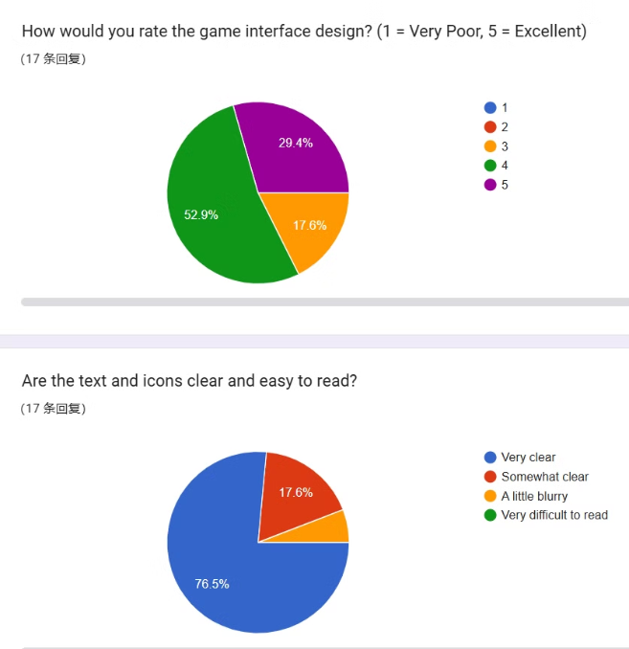
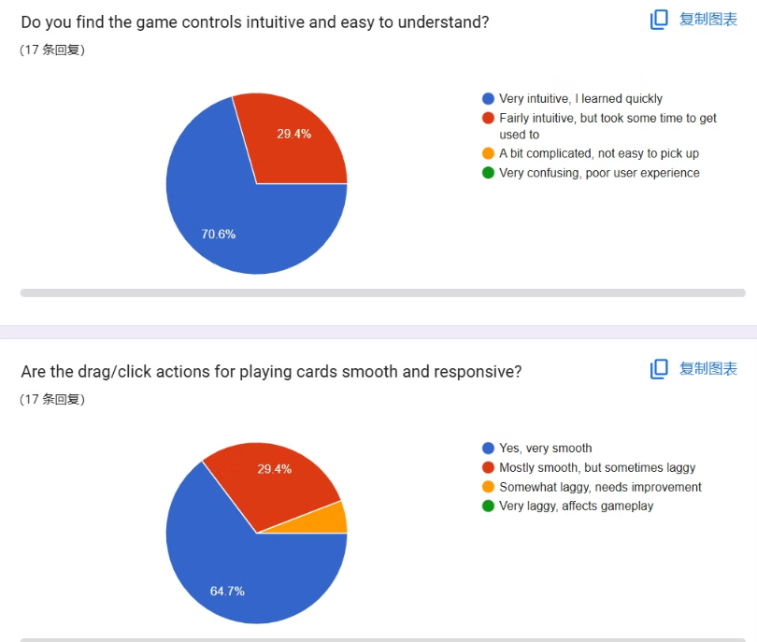
Usability Testing Feedback

Slide 12


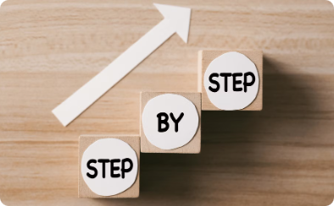
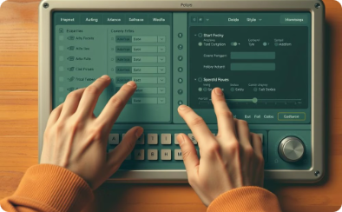
GenderMag Analysis
Friendly to all genders
Intuitive Interface
Clear Instructions
Adaptable Usability
Accommodating diverse personalities and preferences from all genders.
Easy-to-follow buttons and simple text guide users.
No ambiguous instructions or redundant text.
Easy to use for both tinkerers and those who prefer instructions.

Slide 13

Project Qualities
Portability
Runs seamlessly on desktop — built with Unity for maximum reach.
Low-Cost
Built entirely with free and open-source tools. No licensing.
Installability
Easy setup process
Performance
Optimized for smooth gameplay

Slide 14


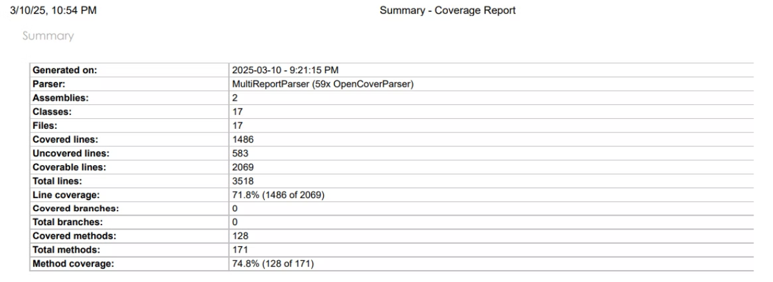
Testing and Validation
Unit Tests
Component Validation
Over 50 unit tests implemented, achieving 71.8% code coverage.
Ensured individual components function correctly through rigorous testing.

Slide 15






Impact and Takeaways
Engaging Gameplay
Delivers a polished, exciting Uno Flip experience that rivals commercial games.
Technical Challenge
Built complex multiplayer networking, card effects and rule-based AI.
Practical Skills
Applied Unity, C#, Git, and testing frameworks — skills we’ll carry into the workforce.
This wasn’t just coursework — we built, tested, and delivered a complete game experience from the ground up.

Slide 16

Disadvantages & Future Work
Limited Scope
Resource Constraints
Focused on core features, some advanced functionalities were omitted.
Development time and team size limited the project's complexity.
Future Development/Documentation
Explore advanced features, improve AI, and expand platform compatibility. Update any previous documentation.

Slide 17
Conclusion and Questions
Thank you for joining us today. We hope you enjoyed the presentation about our project.
Now, we'd be happy to answer any questions you may have.

